Slide 1
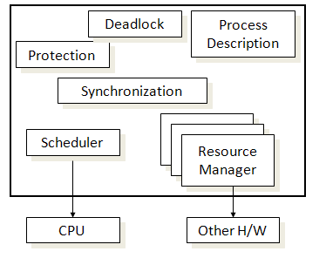
Process manager

Slide 2
Process manager responsibilities
Process creation and termination
Thread creation and termination
Resource allocation
Protection & security
Implementing address space
Providing mechanisms for process synchronization
Providing mechanisms for process communication
Providing mechanisms for deadlock handling

Slide 3
Process management
The process manager creates the environment in which multiple processes co-exist, each with own abstract machine
When hardware process begin to execute OS code, it will execute an algorithm that switches the hardware process from one context to another
These Context switches can occur when ever OS gets control of the processor.

Slide 4
Process context
The context of a process consists of the contents of its (user) address space and the contents of hardware registers and kernel data structures that relate to the process.
Formally, the context of a process is the union of its user-level context ; register context , and system -level context .
The user-level context consists of the process
text, data, user stack, and shared memory that occupy the virtual address space of the process.

Slide 5
Register context
The register context consists of the following component
The program counter specifies the address of the next instruction the CPU will execute;
The processor status register (PS) specifies the hardware status of the machine as it relates to the process.
The stack pointer contains the current address of the next entry in the kernel or user stack, determined by the mode of execution.
The general-purpose registers contain data generated by the process during its execution.

Slide 6
Context Switch
When the kernel decides that it should execute another process, it does a context switch, so that the system executes in the context of the other process
When doing a context switch, the kernel saves enough information so that it can later switch back to the first process and resume its execution.
the kernel saves the context of a process whenever it pushes a new system context layer.

Slide 7
Context Switching
Old process
Descriptor
CPU
New process Descriptor

Slide 8
Process Creation and Execution
UNX process management separates the creation of processes and the running of a new program into two distinct operations.
The fork system call creates a new process.
A new program is run after a call to execv.

